Slide 1

2
COMPUTER HARDWARE
CMT 102/LIS 103:-Fundamentals of Computing
Doreen Mango
Phone:+254-722-171-281
Email:doreen@cuea.edu

Slide 2
CHAPTER OBJECTIVES
    By the end of this chapters, learners should
      Understand what is meant by computer hardware
      Differentiate between computer hardware and software
      Identify the different computer hardware that make up computer based system
      Exhibit the architecture of the Von Neumann architecture

Slide 3
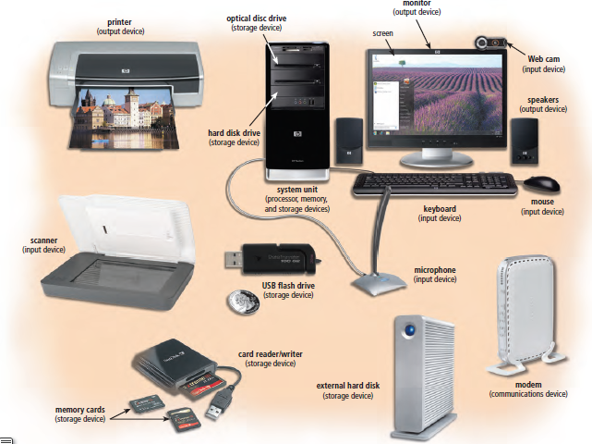
HARDWARE COMPONENTS OF COMPUTER SYSTEM

Slide 4
Functional components of a CS
    divided into four functional parts namely
      Input
      Processor/Central Processing unit (C.P.U)
      Output
      Storage
CMT 316 User Profile Analysis|CUEA 2017

Slide 5
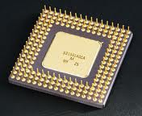
CPU
      Brain of the computer where data and instructions are decoded & executed.
      Consists of three associated elements i.e.
        ALU, CU & register
CMT 316 User Profile Analysis|CUEA 2017

Slide 6
Control Unit (CU)
    Regulates operations of the computer system.
    Fetches instructions ,decode &supervise their execution by sending appropriate signals to respective devices.

Slide 7
Registers
    They are high-speed buffer storage areas used to temporarily hold small units of program instructions and data immediately before, during, and after execution by the CPU.

Slide 8
Main Memory
    Also know as Primary Storage/Immediate Access storage/Internal Storage/Temporary
    holds data and instructions required by the processor immediately.

Slide 9
Secondary/backing/auxiliary storage
    Allows organizations need to store large amounts of data, instructions, and information more permanently
    adv of non volatility, greater capacity, and greater economy.

Slide 10
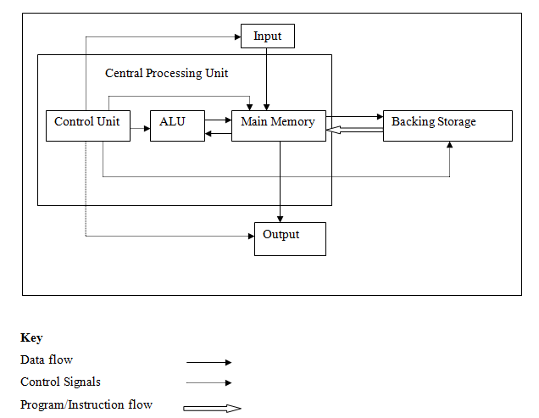
Von Neumann Architecture

Slide 11
Computer Bus
    Highway/pathway for transmitting signals between computer components. Can be internal/external
    Functions
      Data sharing
      Power
      Timing
    All buses consist of two parts an address bus and a data bus.
    Bus width determine the how much data can be transmitted at ago

Slide 12
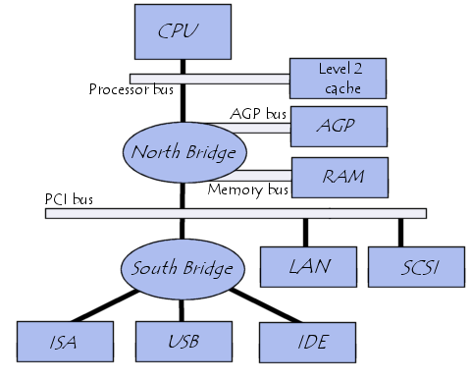
Computer Bus

Slide 13
Registers
    Memory Data Register (MDR)
    Memory Buffer Register (MBF)
    Sequence Control Register (SCR) /Program Counter (PC)
    Memory Address Register (MAR)
    Instruction Register/Current Instruction Register
    Accumulator
    Status register

Slide 14
Fetch execute cycle
    Fetching, decoding and executing instructions within the computer.
    CU-fetches instructions to be executed from the Main memory.
    CPU- interpretate/decodes instruction-to understand what operations are to be done.
    A number of registers are involved in this.

Slide 15
Fetch e cycle
    The PC moves its contents to MAR from where it will be read and used to access the instruction from the main memory through the MBR.
    The instruction is then moved to CIR where it is interpreted/decoded awaiting to be executed marking end of the instruction/fetch Cycle

Slide 16
Execute Cycle
    ALU does what its instructed to do.
    C.U then sends appropriate signals to the required devices and then supervises the execution of this instruction.
    The time taken is called the Execution time or the E-time.
    The execution and instruction cycle together make up one machine cycle.
    Carried out in controlled timings using an internal system clock.
    The cycles are measured in Hertz (cycles per second).

Slide 17
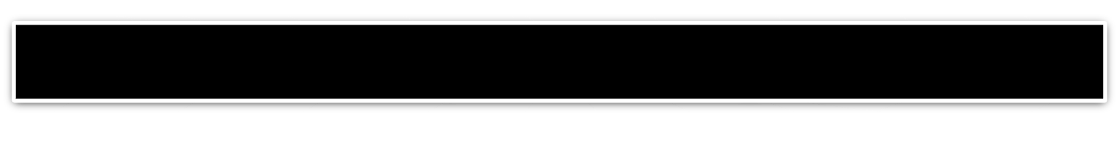
Computer Storage
    Divided into two categories
      Primary storage (RAM & ROM)
      Secondary storage

Slide 18

Primary Storage
Provide CPU with a working storage area for program instructions and data.
Primary storage is used to hold
  Instructions awaiting & currently being to be obeyed
  Data awaiting & currently being processing
  Data awaiting output

Slide 19
Types Of ROM
PROM
  can be programmed by a user but the data is held permanently once programmed hence expensive
EPROM
  Can be programmed, be erased and reprogrammed by user.
  You need to remove EPROM from the computer in order to erase its contents.
EAROM
  Can be read, erased and re-written without having to remove them the computer system.

Slide 20
Secondary Storage
Stores instructions and data not currently needed by the processor.
  The main memory is very expensive
  RAM is volatile
  Greater capacity
  For easy portability where there maybe is no network.
  Security purposes (data is not accessible to all people).
  For back up purposes in case of hard ware corruption.
Examples include Magnetic tapes, magnetic discs, optical discs, solid state storage devices

Slide 21
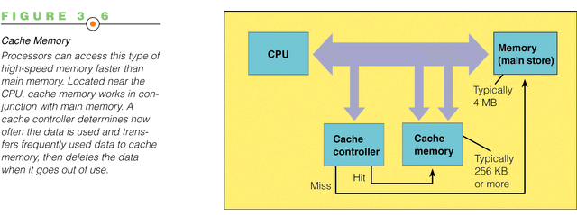
Cache memory

Slide 22
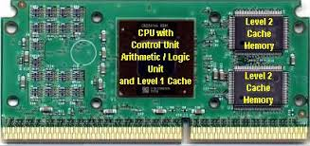
Cache memory

Slide 23
Enterprise Storage Options
Businesses need to store large amounts of data created throughout the organization.
Such large secondary storage is called enterprise storage.
    Attached storage
    Network-attached storage (NAS)
    Storage area networks (SANs)

Slide 24
Attached storage (AS)
Tape, hard disks, and optical secondary storage devices are connected directly to a single computer.
simple and cost effective for single users and small groups
They do not allow systems to share storage.
complicates backing up process

Slide 25
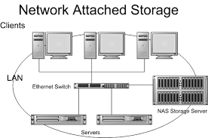
Network Attached Storage

Slide 26
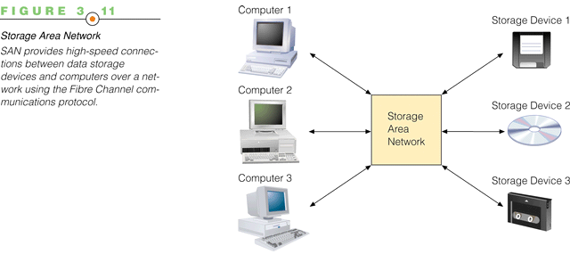
Storage Attached network

